Slide 1

Project Presentation Database Management System
Course Code:CD252IA
TOPIC - Mental Health Support System
NAME | USN
Anant Tewari | 1RV22CD005
Kiran R Aithal | 1RV22CD022
Shridhar Bhat | 1RV22CD056
SUBMITTED TO
Dr. Pavithra H
Assistant Professor, Dept. of Computer Science and Engineering ,RVCE

Slide 2
INTRODUCTION
The Mental Health Support System is a database management system (DBMS) designed to assist mental health professionals in managing virtual therapy sessions effectively. This system centralizes patient data, streamlines session documentation, tracks progress, and enables patients to access self-care resources. It addresses the growing demand for accessible and efficient mental health support by offering a secure and user-friendly platform.

Slide 3
PROBLEM STATEMENT
Therapists struggle with managing appointments, patient details, appointment scheduling, maintaining notes efficiently and ensuring secure data handling, while patients face difficulty finding suitable therapists.
There is a need for a centralized platform that integrates patient management, appointment scheduling, feedback collection, and secure notes management while ensuring data security through role-based access and password hashing.

Slide 4
LITERATURE SURVEY
SI.NO | AUTHOR | PAPER TITLE | SUMMARY
1 | Abha Tewari, Sudha Kallakuri, Siddhardha Devarapalli, David Peiris, Anushka Patel and Pallab K. Maulik | SMART Mental Health Project: process evaluation to understand the barriers and facilitators for implementation of multifaceted intervention in rural India | The SMART Mental Health Project was implemented across 12 villages in West Godavari district, Andhra Pradesh, to bridge treatment gaps for common mental disorders (CMDs) through community campaigns. The process evaluation used a mixed-methods approach, including quantitative service usage analytics and qualitative data from interviews and focus groups with stakeholders. Key Facilitators included effective training, supervision, and awareness programs, while barriers involved stigma, limited knowledge, travel distance, and poor mobile connectivity. https://doi.org/10.1186/s13033-021-00438-2 International Journal of Mental Health Systems (2021)

Slide 5
LITERATURE SURVEY
SI NO | AUTHOR | PAPER TITLE | SUMMARY
2 | Nazmul Hassan Najib, Maksudul Islam Chowdhury, Kamrujjaman | IoT based system for Smart Mental Health Support (2023) ScienceOpen | IoT technologies was used to create a comprehensive system that supports mental health through Wearable Devices to continuously monitor physiological and behavioral markers, such as heart rate, sleep patterns, and activity levels, providing real-time data on the user's mental health status. This web app addresses mental health challenges by enabling remote consultations between patients and professionals through video, audio, and text communication. It offers features like in-app therapy (e.g., breathing exercises, motivational content) for personalized care. Designed for accessibility, it supports introverts and underserved populations, providing a user-friendly platform tested for efficiency.

Slide 6
LITERATURE SURVEY
SI.NO | AUTHOR | PAPER TITLE | SUMMARY
3 | Batyrkhan Omarov, Sergazi Narynov and Zhandos Zhumanov | AI-Enabled Chatbots in Mental Health: A Systematic Review (2023) TechScience Computers, Materials & Continua 10.32604/cmc.2023.034655 | This systematic review examines the application and effectiveness of AI-enabled chatbots in mental health care. The authors highlight the increasing use of AI chatbots to provide psychological support and therapy, which can bridge the gap in mental health services, particularly in remote and underserved areas. Discusses the benefits, such as accessibility and anonymity, and challenges, including ethical and privacy concerns. The authors also explore the technological advancements in natural language processing and machine learning that have facilitated the development of more sophisticated and empathetic chatbots. They emphasize the need for rigorous clinical validation and ethical guidelines to ensure safe and effective use of these technologies. Concludes by calling for more research to optimize these tools for diverse populations and settings.

Slide 7
PRESENT SYSTEM
• Spreadsheets or Paper-Based Records: Inefficient and error-prone for storing patient information.
• Security Gaps: Existing systems often lack robust security measures like role-based access and encryption, risking sensitive data exposure.
• Lack of Integrated Features: Fragmented, offering separate modules integrated approach, where all features are available in a unified platform, is not always available.
• Manual Scheduling Processes: Appointments are booked and managed manually, resulting communication gaps.
• Limited Patient Engagement: Many platforms do not engage patients outside of scheduled sessions, offering little in the way of ongoing support or resources.
• Lack of AI-Driven Insights: Existing systems do not leverage machine learning to analyze social media data, missing opportunities for proactive mental health predictions and personalized recommendations.

Slide 8
PROPOSED SYSTEM
Centralized Patient Database: Stores patient profiles, diagnoses, and therapy goals for effective management.
Appointment Scheduling & Tracking: Allows therapists to manage appointments with patients and track session times.
Appointment Notifications: Sends updates about upcoming appointments to patients and therapists.
Feedback Collection: Enables collection of patient feedback after each appointment, including ratings and comments.
Payment Management: Tracks payments made for each appointment, including payment details and methods.
Enhanced Security: Role-based access control, Data security through password hashing safeguarding user credentials.

Slide 9
OBJECTIVES
Centralized Platform: Role-based access for storing patient/therapist profiles, live chat, chatbot support, payments, and appointment tracking.
Appointment Management: Comprehensive scheduling system for patient-preferred sessions, plus flexible notes management and rescheduling for therapists.
Mental Health Prediction: Analyze social media usage to predict mental health status, providing tailored self-care recommendations.
Admin Dashboard: Verify therapists, manage user accounts, and oversee appointments for quality control.
Email Notifications: Real-time updates for profile creation, verification, and appointment confirmations/cancellations.
Feedback & Payment: Collect session ratings/comments, track payment details, and assess therapy quality.

Slide 10
INNOVATIVE COMPONENT
Mental Health Status Predictor: Ensemble of ML algorithms (RF, KNN, DT, LR, SVM, Stacking) with weighted voting for high-accuracy emotion/disorder detection.
Secure Authentication & Session Notes: Robust password hashing and isolated therapist-only access protect credentials, patient data, and session notes.
Dialogflow Chatbot: Dynamic knowledge base plus advanced NLU for personalized mental health support, handling unrecognized queries gracefully.
Real-Time Live Chat: Secure, interactive communication channel between patients and therapists for immediate support.
Appointment Scheduling: Streamlined booking, rescheduling, and cancellation with automated email alerts.

Slide 11
Data Collection
MySQL: Collects and stores patient details, therapist profiles, appointment schedules, and feedback data. Structured queries fetch and organize data for effective display and analysis.
Registration Forms: Patients and therapists provide personal details, including roles, during registration, which is stored in MySQL.
Appointment Booking: Patients schedule therapy sessions, and the data is logged with dates, times, and therapist details.
Feedback Submission: Patients provide session feedback, stored in the database for analysis.
Session Management: Therapists log notes and progress updates, adding to a centralized data repository.

Slide 12
Functional Requirements
User Registration and Login:
Patients and therapists should be able to register and log in securely.
Patients provide personal details, contact information, and therapy goals during registration, Therapists provide their specialization and contact details.
Appointment Management:
Patients can book, reschedule, or cancel appointments.
Therapists are notified when a patient books an appointment.
Patients and therapists can view their schedules.
Notifications:
Patients receive reminders for upcoming appointments.
Therapists receive notifications for new bookings.
Data Access:
Therapists can only access data (like therapy goals and notes) of their assigned patients to maintain privacy.

Slide 13
Non - Functional Requirements
Availability:
Accessible 24/7 for booking appointments or viewing therapy-related information.
Maintainability:
The system should be modular, allowing for easy updates and maintenance.
Usability:
The system should have an intuitive interface for patients and therapists.
Mobile-friendly design for ease of access on smartphones.
Security:
Data must be encrypted during transmission and storage.
Role-based access control ensures data confidentiality.
Implement measures to prevent unauthorized access, such as two-factor authentication.

Slide 14
Relational Database Structure
Patients: PatientID (PK), Name, Age, Contact Info, Diagnosis, Therapy Goals
Therapists: TherapistID (PK), Name, Specialization, Contact Info
Appointments: AppointmentID (PK), PatientID (FK), TherapistID (FK), Date, Time
Feedback: FeedbackID (PK), AppointmentID (FK), Rating, Comments, Date
Payment Records: PaymentID (PK), PatientID (FK), AppointmentID (FK), Amount, Payment Date, Payment Method

Slide 15
Relational Database Structure
One-to-Many:
Patients to Appointments
Therapists to Appointments
Patients to Payment Records
Therapists to Feedback
One-to-One:
Appointments to Feedback
Appointments to Payment Records

Slide 16
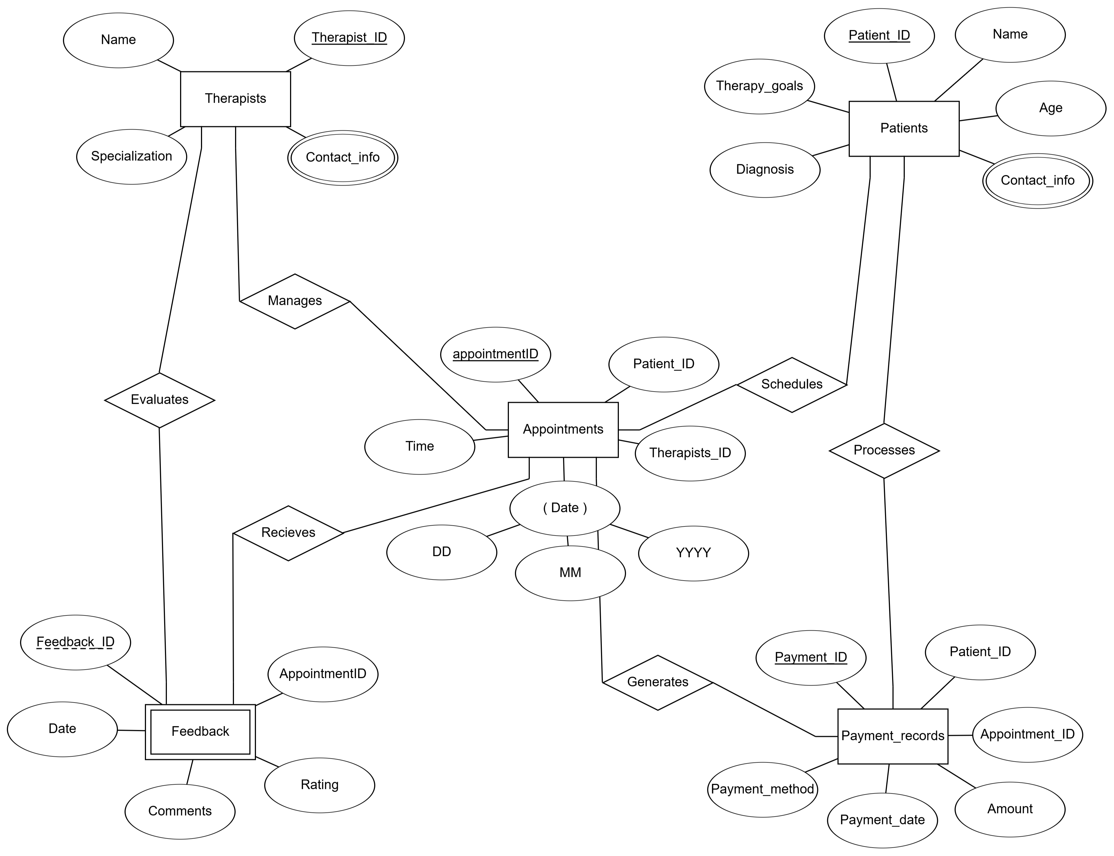
Relational Database Structure
1
1
1
1
N
N
1
N
N
1
1
1

Slide 17
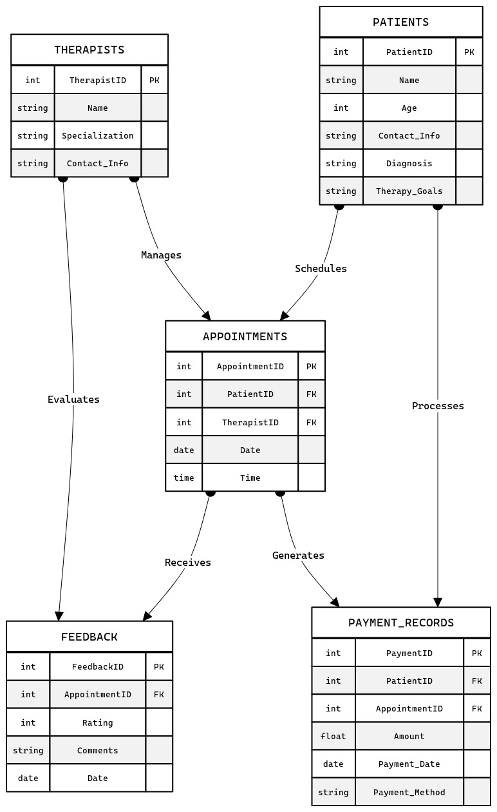
Relational Database Structure

Slide 18
SOCIETAL CONCERN
Improved Access to Care: The centralized platform and integrated features ensure that mental health services are accessible to all, reducing disparities in care across urban and rural communities.
Enhanced Privacy and Data Security: Robust security measures such as role-based access and encryption provide confidentiality of sensitive information.
Supports mental health professionals: Streamlined appointment scheduling, live chat, integrated feedback/payment systems reduce administrative burdens on therapists, allowing them to focus more on patient care.
24/7 Accessibility: The platform allows patients and therapists to access mental track progress and manage appointments at any time enhancing the flexibility.
Reduction of Mental Health Stigma: Secure, anonymous communication channels encourage individuals to seek help without fear of judgment, fostering a more supportive societal attitude towards mental health.

Slide 19
H/W AND S/W REQUIREMENTS
Database Management Systems:
RDBMS: MySQL Database (for structured data).
Development Tools:
Programming Languages: Python (backend), JavaScript (frontend).
Frameworks:
Flask for the backend.
HTML, CSS, JS for the frontend.
API Development: RESTful API
Desktop or laptop with:
Processor: Intel i3 or above (or equivalent).
RAM: 4 GB (minimum).
Storage: 10 GB free disk space.
Display: Minimum resolution of 1280x720 pixels.
Operating System:
Server: Linux-based OS (e.g., Ubuntu Server, CentOS) or Windows Server 2019/2022.
Client Devices: Windows 10/11, macOS, or Android/iOS for mobile access.

Slide 20

THANK YOU

Slide 21
RDBMS AND NoSQL Integration
Data Stored in RDBMS: Both structured data (such as Patient, Therapist, Appointments, and Payment Records) and unstructured data (such as Patient Feedback) are stored in the relational database to maintain strict consistency and integrity. Modern RDBMS capabilities, such as JSON allow for flexible storage and querying of unstructured data within the same system.
Integration Approach: Since all data resides in the RDBMS, no external integration is required. For example, a patient’s profile, appointment history, and feedback are stored together in relational tables, ensuring a unified view of their journey while simplifying architecture and data management.

